Slide 1

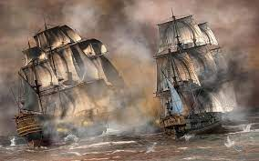
- 1 -
SEQUENCE OF PLAY
GAME PLAY
- 2 -
SEQUENCE OF PLAY
PIRATE TURN PHASES
- 3 -
SEQUENCE OF PLAY
PIRATE ACTIONS
- 4 -
SEQUENCE OF PLAY
ANTI PIRATE ACTIONS
A ship with Scurvy: Loyalty -1
1. CARD DRAW PHASE
Draw one card at a time, resolving any Play Immediately cards, until holding 4.
2. MERCHANT SHIP PHASE
If < 5 merchants on the map, then increase to 6 by d66 rolls.
3. CARD PLAY PHASE: Play 1-4 cards.
Only one can be used for actions.
Event played: others cannot take any AP Actions.
Actions played: number of actions is on card; they may be split among pirates in play. Diamond gives actions equal to Initiative of ONE Pirate (cannot be split among pirates).
4. CHANGE PIRATE PLAYER
Each Action allows the Pirate to perform ONE of the following Pirate Actions.
Move
Find Merchant Ship
Loot Merchant Ship
In-Port Activities
Boot Grab
D&R Recovery
Attack Port
Sack Port
Form Pirate Alliance
Retire Voluntarily
Draw New Pirate Card and/or Deploy New Pirate
The AP Action types are as follows:
Attempt to Deploy a King’s Commissioner (KC)
Use On Station Warship
Use Existing KC
Play an AP Event Card Action
No AP Action type may be played more than once against active Pirate during any given Action.
No AP Event Card action type may be played more than once during that player turn.
KC Reaction is not considered an AP Action type. It does not count as the AP Action played for that AP Player.
KC
WAR
KC
Takes a turn as a Pirate Player (PP), during which EACH of the other players, as Anti-Pirates (AP), may get ONE AP turn.
The game end when General Pardon Event Card is played for the third time.
KC
Blackbeard Golden Age of Piracy – Sequence of Play Cards (Sheet 1 of 2: Front) Template by STUKA JOE
EVENT CARD
#1 – Buried Treasure (1)
EVENT CARD
#2 – Debauchery & Revelry (6)
EVENT CARD
#4 – Double Cross (4)
EVENT CARD
#8 – General Pardon (1)
The card remains in front of the player until he visits the Isle of Pines (below Cuba), when it is discarded. If the pirate retires or is eliminated the card is discarded. Spend 1 action to move onto the island (this is not an in-port move) and dig for treasure.
Play after target pirate has completed his in-port action.
Can be played against any one other player’s pirate currently in-port. May not be played against a Pirate who already has a D&R marker.
That crew suffers involuntary D&R.
Play when a Pirate states he is using is Letter to Retire.
Played three times during the game
The first time, no effect; put back in Event Deck and reshuffle (not including Discard Pile)
The second time, a General Pardon is issued to all Pirates on map. The Pardon last until Player who played this card completes his next Player Turn.
Every Pirate who moves into an English Port is Pardoned and is Retired (mandatory), after converting Booty to Net Worth
No Pirate may attack an English Port
The General Pardon Card is reshuffled to Event Deck when 20 or less card remaining (not including Discard Deck)
The third time, the game is over. Determine the winner.
Roll d6:
1-2 | Insufficient evidence: pirate may retire
3-4 | Put on trial. 2d6 x 10% (rounded up) of the pirate’s Net Worth must be paid to be acquitted. Treat a roll of 10-12 as 100%
5-6 | Tried, convicted and hanged, lose all Net Worth
Roll d6:
1-2 | Nothing found
3-6 | 3d6 x 100 doubloons (add to any hold)

Slide 2


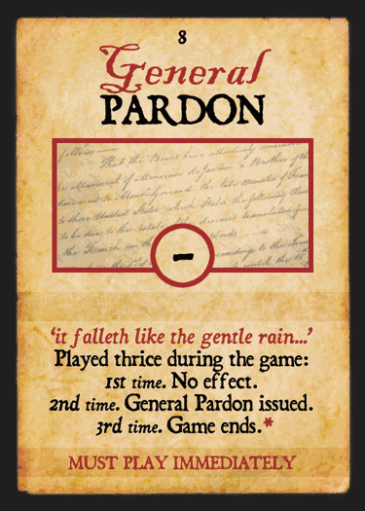
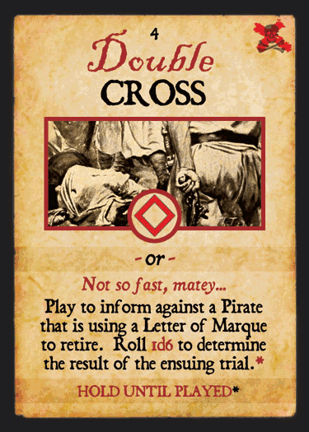
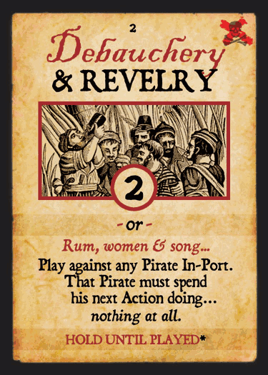
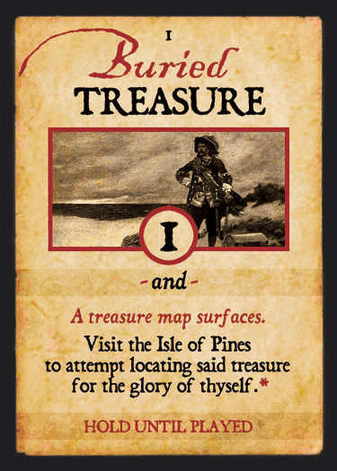
Blackbeard
The Golden Age of Piracy
Blackbeard
The Golden Age of Piracy
Blackbeard
The Golden Age of Piracy
Blackbeard
The Golden Age of Piracy
4
Sequence of Play
3
Sequence of Play
2
Sequence of Play
1
Sequence of Play
Blackbeard Golden Age of Piracy – Sequence of Play Cards (Sheet 1 of 2: Back) Template by STUKA JOE
Blackbeard
The Golden Age of Piracy
Blackbeard
The Golden Age of Piracy
Blackbeard
The Golden Age of Piracy
Blackbeard
The Golden Age of Piracy
#8 Event Card
Description
#4 Event Card
Description
#2 Event Card
Description
#1 Event Card
Description

Slide 3
EVENT CARD
#9 – New Governors (8)
EVENT CARD
#11 – KC Surprise (2)
EVENT CARD
#12 – Letter of Marque (4)
EVENT CARD
#17 – Piratical Ambition (5)
Roll d66 twice and place a new Anti-Pirate governor on those ports, removing an existing Pro- or Anti-Pirate governor if necessary.
If the roll indicates a Pirate port, roll again.
Pirates are automatically ousted from ports where Anti- Pirate governors appear.
Play immediately after any AP player uses a Warship Sighting card to attempt to attack a pirate
Played during and as part of a pirate’s In-Port Activity action. May be assigned to the player’s pirate who is in port with a Pro-Pirate governor. He may do one of the following:
Treat every other port of the same nationality as a Pro-Pirate governor port, regardless of the governor there. Place an appropriate Nationality marker in the Letter of Marque box on his display; or
Retire without any ill-effect (unless someone plays a Double Cross card); or
Surrender to a KC and Retire
No Pirate may have more than one Letter of Marque at any one time. After use, a Letter of Marque card is removed from game
May be played only by a player with a pirate card in his hand and without his maximum number of pirates in play
The player uses his in-hand pirate to fight a Duel:
If the in-hand pirate wins, the target pirate is marooned and eliminated, losing his Net Worth (but not his Notoriety Points). The new pirate takes over his ship and everything on it (except the Net Worth, Notoriety and Cunning markers which are removed) and Crew Loyalty is placed at 6.
If the in-hand pirate loses, he is killed and never gets into the game, and Crew Loyalty is increased by +1.
The player playing this card must not already have a KC.
The warship turns out to be a KC (no Notoriety roll required).
The attack now proceeds immediately as an attack by the KC (who must intercept the pirate first), not a warship, and the KC belongs to the card player.
This is an exception to the rule of being able to play only 1 AP Event card per turn and 1 AP Event card type per action, since it may be played with a Warship card by the same player.
Blackbeard Golden Age of Piracy – Sequence of Play Cards (Sheet 2 of 2: Front) Template by STUKA JOE
EVENT CARD
#18 – Scurvy Outbreak (5)
EVENT CARD
#19 – Skull & Crossbones (4)
EVENT CARD
#20 – Storm at Sea (6)
EVENT CARD
#23 – Natural Disaster (1)
Played against an active pirate not in-port and who does not already possess a Scurvy marker.
Place a Scurvy marker on the ship and decrease Crew Loyalty by -1.
Any hostage on board dies immediately.
Every time the pirate starts a turn, he further reduces Crew Loyalty by -1 (never below 0) until he enters Port and the marker is removed.
Play at any time (during his own turn on another’s) at the cost of 1 of that pirate’s Cunning Points.
May be used for one of following:
It negates any one card just played against him. The negated card is placed back in the deck and the deck reshuffled (without the discard pile); or
If the pirate is the target of a Booty Grab action, add +2 to his roll.
Remove all merchant ships in the area
Roll 2d6 for any warship in the area; if the result is higher than its Combat rating, remove the warship.
Roll a die for each KC in the Sea Area; on a roll of 1-4 KC is placed back in the KC pool
For each pirate in the area not in-port, roll d6 (add +1 if the pirate is in a transit box):
Once per game event. Permanently remove the card from the game after use.
Roll d6:
1 | Bermuda | 4 | Port Royal
2 | St. Augustine | 5 | Port O’Spain
3 | Isla de Tortuga | 6 | Campeche
The indicated port is totally destroyed; everyone (pirate, hostage, governor etc.) there dies, and the port is no longer usable (place a Port Destroyed marker).
Remove all merchant ships from the map and replace 8 as though setting up the game.
Roll d6:
1-2 | 1 Speed damage hit
3-5 | 2 Speed damage hits
6 | 3 Speed damage hit
7 | Ship Sunk

Slide 4
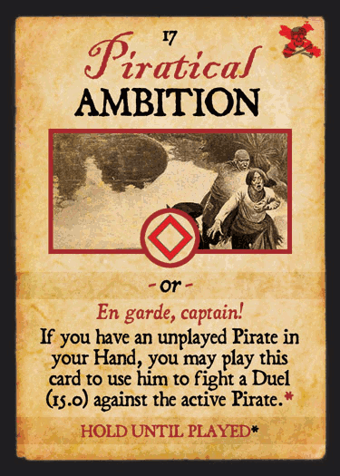
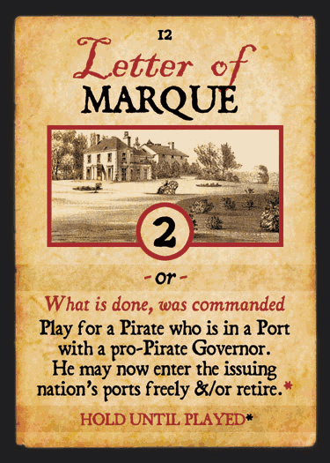
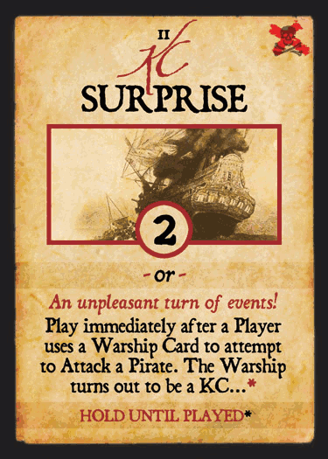
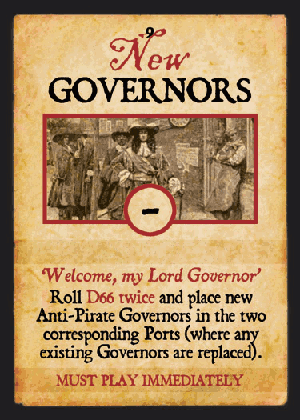
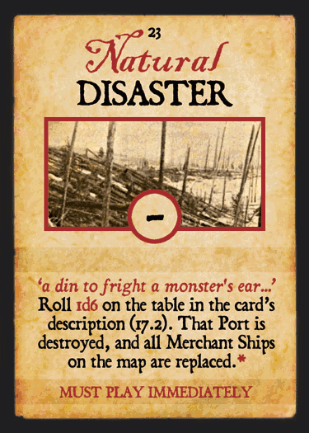
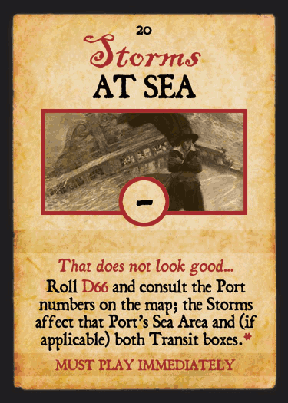
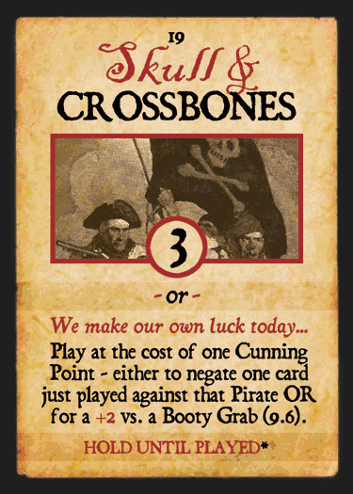
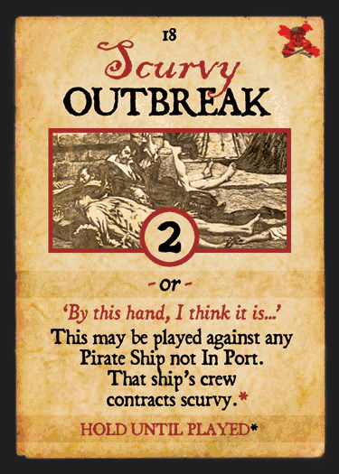
Blackbeard
The Golden Age of Piracy
Blackbeard
The Golden Age of Piracy
Blackbeard
The Golden Age of Piracy
Blackbeard
The Golden Age of Piracy
#17 Event Card
Description
#12 Event Card
Description
#11 Event Card
Description
#9 Event Card
Description
Blackbeard Golden Age of Piracy – Sequence of Play Cards (Sheet 2 of 2: Back) Template by STUKA JOE
Blackbeard
The Golden Age of Piracy
Blackbeard
The Golden Age of Piracy
Blackbeard
The Golden Age of Piracy
Blackbeard
The Golden Age of Piracy
#23 Event Card
Description
#20 Event Card
Description
#19 Event Card
Description
#18 Event Card
Description

Slide 5

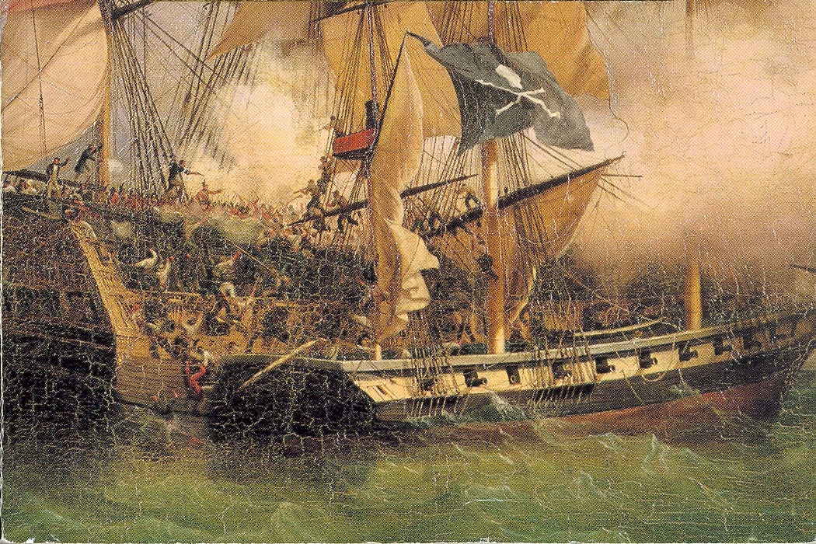



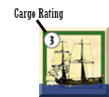




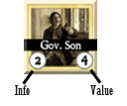



Pirate Actions
Find Merchant Ship
In same zone as merchant port
Rolls: * +
* +1 if Merchant already flipped
If 7+, flip Merchant if not already
May Loot on next action only
D&R Recovery
Must be in port
1 action to remove Voluntary D&R marker
2 actions to remove Involuntary D&R marker
Attack Port
Must be in adjacent sea
Rolls: + Combat + + Port Info
Port Rolls: * + Defense
* if previously attacked
If Attack > Defense, success
Gain Booty: * x 100
* # of dice = port value
Gain Notoriety: 2 x port value
-1 Combat Damage
+1 Loyalty
Enter the port
If Attack <= Defense, failed
Combat Damage = Port Roll - Roll
Mark port attacked
Add nation to ship’s attack history
Ports of that nation are now for attacking Pirate
loses (remove from game) any Letter of Marque he has if obtained at a port of the same nationality
KC
KC
WAR
WAR
Move*
Sea to Port (or vice versa)
May not enter port unless it is a safe haven
Sea to Sea
Sea to Transit (or vice versa)
* Takes 2 actions if speed < 0
KC
Cargo Table
Result | Atlantic | Caribbean & Americas | Africa & Gold Coast | India
1 | 0 | 100 | 50 | 500
2 | 100 | 400 | 150 | 1000
3 | 200 | 600 | 300 | 1200
4 | 300 | 800 | 500 | 1500
5 | 400 | 1000 | 600 | 1800
6 | 500 | 1200 | 700 | 2000
7 | 600 | 1300 | 800 | 2500
8 | 700 | 1500 | 1000 | 3000
9 | 800 | 2500 | 1200 | 4000
10 | 1000 | 3000 | 1500 | 7500
Loot Merchant Ship
Must follow Find Merchant Ship
Determine Booty
Rolls: + Cargo Rating
Cross reference result on Cargo table
Take or Leave the Booty
If left, -1 Loyalty
Convert Merchant Ship
Change ship type to merchant ship type
Reset Speed and Combat ratings
Adjust Loyalty
+1 Loyalty for bigger ship
-1 Loyalty for smaller ship
Draw and Deal with Hostage
Ransom
Take Hostage aboard with nationality token
Torture
Rolls:
If result > receive Info value for that port
Adjust Notoriety and Loyalty
For Looting
Notoriety Gain: ship value
Loyalty: -1 for 1-3 results on Cargo table, +1 for 8-10 results
For Torturing Hostage
Notoriety Gain: Hostage value
Return Merchant Ship to pool
May Declare D&R
+1 Loyalty
KC
-1 Loyalty
WAR
Draw New Pirate Card and/or Deploy New Pirate
Pirate Card limits:
Players | In Hand | In Play
4 or 5 | 3 | 2
3 | 3 | 3
2 | 4 | 4
+1 Loyalty
In Port Activities
Must be in a port
Ransom Hostage(s)
In Ports of same nationality as hostage
x Hostage Value x 50 in booty
Convert Booty to Net Worth
Pro-Pirate/Pirate Port: 1:1
Neutral Port: 1:2
Safe Haven: 1:1 + 10%
Refit
Restore speed and/or combat values
½ x * repair points (rounded up)
* +2 in Safe Havens
Complete repair in Pirate Port
Establish Safe Haven
Bribe governor
Bribe cost: x 100 Net Worth
If paid, mark Safe Haven status
If not, place «bribed» chit on ship (unable to bribe again)
Enter D&R
Voluntary: +1 Loyalty
Involuntary: if Booty converted in Pirate Port, +3 Loyalty
Form Pirate Alliance
Between two Pirate of the same player in the same port
Effects
Pirates move together
Combat rating = stronger ship + 1
Speed rating = slower ship value
Loyalty = lower ship value
Pirate rating = owner’s choice
Notoriety and Booty split evenly
Ship damage divided evenly
Sack Port
Must follow successful port attack
Rolls: +
If > port defense, success
Gain Notoriety: 2 x port value
+2 Loyalty
Mark port Destroyed
move to adjacent sea
Involuntary D&R
If <= port defense, failed
may not try to Sack the port unless he leaves and attacks again
Booty Grab
Must be in port with a D&R enemy pirate
Each rolls: * +
*booty grabber gets + 1
If >, then success
+ initial rolls’ difference = % of booty grabbed
If =, then Duel
If <, then failure
Booty grabber -2 Loyalty
Retire Voluntarily
Must be in a port
Can retire automatically if:
Has Letter of Marque for port nationality
In Safe Haven
Can bribe governor in pro-pirate ports
Bribe cost: x 100 Net Worth
If bribe not paid,
-1 Loyalty
Place «bribed» chit on ship

Slide 6
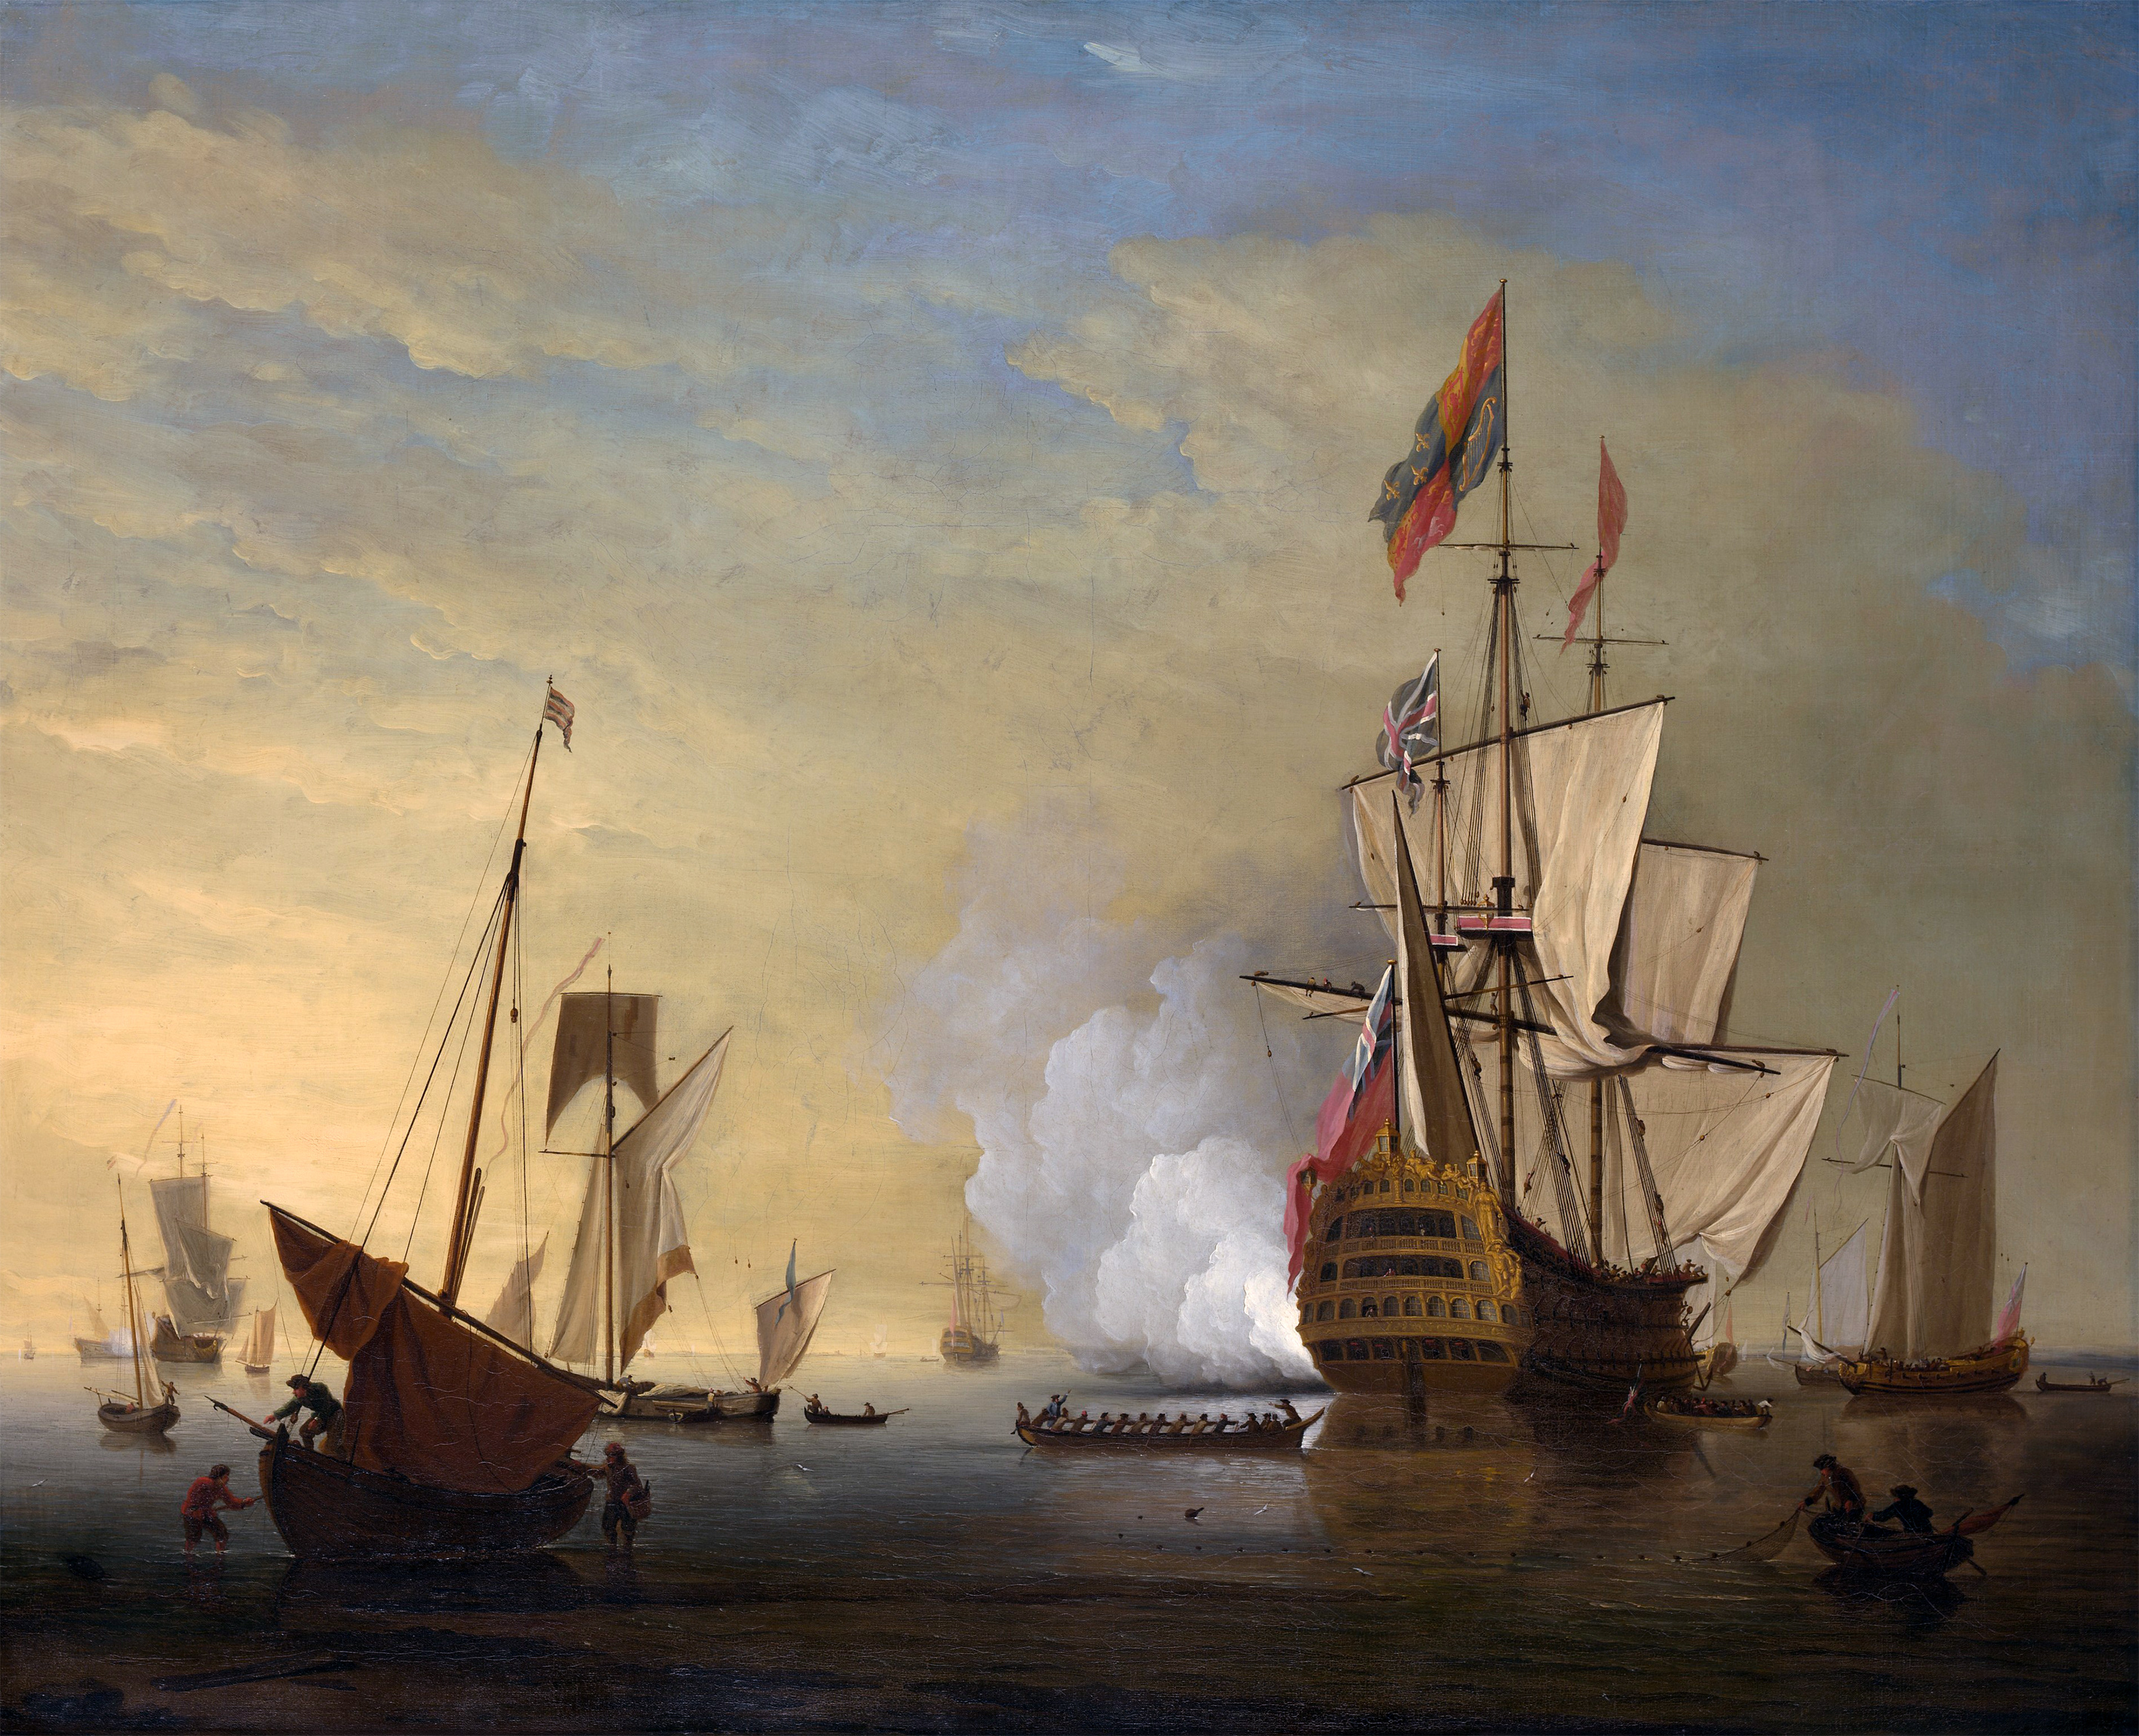



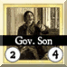
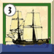

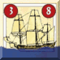

AP Actions
Play a Warship Sighting Event Card
Place randomly drawn in the same sea as
Only one in a Sea Area
May Use immediately
Others
Mutiny
By Event or when Crew Loyalty reach 0
Roll: and compare with
If >, then success
is Eliminated
Replaced by an in hand Pirate Card (if any) or by a Pirate Card drawn from top of deck. If none, ship is lost
If =, then failed but
-1 Loyalty
WAR
Attempt to Deploy a
Not against in a port or Transit Area
Rolls:
If < Notoriety
Place randomly drawn in sea are with
Deploying player controls
Each player can control on max 1 at a time
The new is able to React immediately
Reaction
Only in response to noted pirate actions
decides to Evade or Fight
If Evade, then
Rolls: * + Speed
* -1 if moving from an adjacent sea area
Rolls: + Speed*
* -2 for D&R
If roll > roll, Fight
may use Letter of Marque (any nationality) to Retire
Else escapes and may not continue action (except move)
Return involved merchant ships to the pool
If Fight, then
Rolls: + Combat
Rolls: + Combat* +
* -2 for D&R
If roll >= roll, success
is Eliminated
If failure,
-1 Combat Damage
+1 Loyalty
Notoriety Gain: 2 x Combat rating
Remove from the game
continues action
KC
KC
WAR
KC
Use a
Only in response to noted pirate actions
decides to Evade or Fight
If Evade, then
Rolls: + Speed
Rolls: + Speed*
* -2 for D&R
If roll > roll, Fight
Else escapes and may not continue action
Return involved merchant ships to the pool
If Fight, then
Rolls: + Combat
Rolls: + Combat* +
* -2 for D&R
If roll >= roll, success
Combat Damage = Roll difference
-1 Loyalty
must stop action
Return involved merchant ships to the pool
If failure,
-1 Combat Damage
Return to the pool
continues action
Notoriety Gain: Combat rating
KC
WAR
KC
KC
KC
WAR
KC
Cunning and Luck
Each Cunning Point allows pirate to reroll (not individual dice, D66 or already cunning)
KC
Use
Only one of the following per AP Turn
Move
Move your in a sea or transit area
Never into ports
Attack a Pirate Port
If no in the port
Port destroyed
If present
Rolls: + Combat
Each Rolls: * + Combat +
* -2 for D&R
If roll > every roll, success
Port destroyed
All move to sea and -1 Combat Damage
Oust Pirates from a Port
Rolls: + Combat
Rolls: + sum of all Combats
* -2 for D&R
If roll > roll, success
All move to sea
If fail,
All earn +1 Notoriety
WAR
KC
KC
Victory Points
Pirate Retire
2 VP per Notoriety
1 VP per 100 Net Worth
Pirate Eliminated (not by ) or still active at game end
1 VP per Notoriety
Pirate Eliminated by
scores 1 VP per Notoriety
controlling scores ½ that amount
KC
WAR
KC
KC
KC
WAR
KC
KC
KC
KC
KC
Counter Legend
Cargo Rating
KC
Duel
Each Rolls: # of =
Highest total wins
Winner can take over any/all victim’s possession (except Net Worth); even his ship
Loser dies
Tied Duel can be re-fought if both players agree
WAR
Info
Value
Speed
Combat
Speed
Combat
KC
WAR
Play a Event Card
Play and resolve the card effect
WAR
KC

Slide 7
SOLITAIRE BLACKBEARD
Two players: You and the System Player (SP). You control Blackbeard Pirate, the SP has 3 Pirates, randomly drawn; 1-4 Sloop ship, 5-6 Schooner. Whenever an SP Pirate retires or is eliminated, draw another Pirate Card.
Game Play: You play your turn, after which all three of the SP Pirates each get a player turn.
Plate Must Play Immediately and Hold Until Played Events card in two separate decks. Remove Finger of Fate and Piratical Ambition cards from the game.
Place 10 Merchant Ships on the map. If the Merchant ship total is below 8, place enough Merchant to bring it to 8
Place 8 Pro-Pirate Governors randomly using d66
Deploy Blackbeard’s counter in the Sea Area with more Merchant Ships; if tie, in the Area with highest number on Cargo Table
Deploy SP Pirate randomly using d66; only one per Area
Draw 4 Hold Until Played cards in your hand and then playing the first card
The Game end when one of the following occurs
Blackbeard successfully Retires with at least 130 VP
Blackbeard is killed
SP acquires at least 100 VP from all his Pirates combined
The instant all SP Pirates are eliminated and no more are available
The General Pardon card is drawn from the Hold in Hand deck for the third times
When the General Pardon card if drawn for the first time, shuffle this card into Hold Until Played deck along with all Hold Until Played discards. From that point, General Pardon functions exactly as in a multiplayer game.
You have a normal hand except that you have no extra Pirate cards. You never draw cards from the Must Play Immediately deck; only SP draws these cards
SP Player doesn’t have a hand. Instead, for each SP Pirate turn, first draw a Must Play Immediately card and play it, and after draws and plays a Hold until Played card.
Every time you perform an Action with Blackbeard, you must stop to see if AP action occurs.
If there is a Warship or KC on the map and Blackbeard conducts an action that would trigger Warship or KC activity, the activity automatically occurs
Otherwise, draw the top card from Hold Until Played deck; play AP action against Blackbeard if possible; discard the card
As soon as Blackbeard’s Notoriety reaches 12, the first SP in each Player turn thereafter will use his AP action to attempt to deploy a KC, placing it in the Blackbeard’s Sea Area. Blackbeard may place and use KCs normally.
Blackbeard may not surrender to a KC; he may Retire only by entering a Port and using Letter of Marque.
Blackbeard never dies from Mutiny; in case of roll higher than his Leadership rating, Loyalty is reduced by 3; if equal to Leadership rating is reduced by 2
Each SP Pirate will use his Actions for the greatest possible gain to himself OR the greatest possible damage to Blackbeard
If an SP draws a Letter of Marque card, he must expend all subsequent Actions to reach a Pro-Pirate Governor; he keep the Letter of Marque card and immediately draws another; after acquiring a Letter of Marque he continues his VP-acquiring mission. Once he is able to gain at least 30 VP from retiring, he will try to do so.
An SP Pirate always choose to voluntarily using D&R when applicable
If Blackbeard’s Crew Loyalty reaches zero, he loses 2d6 worth of Notoriety Points immediately and another 1d6 at the end of every one of his Player turn in which he does not raise the level above zero
GAME SETUP
Players take the following number of Pirate Displays each:
5 or 4 players: 2;
3 players: 3;
2 players: 4.
Roll 1d6. The highest roller is Player A; play passes clockwise. Players take corresponding Pirate ID chits.
Remove Play Immediately cards from the Event deck.
Shuffle the deck and deal 4 cards face down to each player. Re-shuffle the Play Immediately cards back in and place the deck face down on the board.
Place the 8 Pro-Pirate Governors in Port Boxes determined by d66 rolls. If pirate ports or duplicate ports are rolled, use the next available higher-numbered port.
Players randomly draw or choose the following number of Pirate Cards each:
5 or 4 players: 2;
3 players: 3;
2 players: 4.
In player order, deploy 1 Pirate into any sea area (even if occupied). In order, additional pirates may be deployed if desired, 1 at a time, up to the total number held. Place each Pirate ID marker and Pirate Card on a Pirate Display and select a ship type (Sloop or Schooner) for each pirate deployed. Place Combat and Speed markers on the card as appropriate for that ship, and Loyalty Level markers on 7.
Place the 35 Merchant Ships in a cup and draw 8. Place face down in Merchant Boxes (ship icon) at ports determined by d66 rolls. If pirate ports or duplicate ports are rolled, use the next available higher-numbered port.
Place the Victory Point markers for all players in the 0 box of the track (+100 side down). Place the following markers in cups: 9 King’s Commissioners (KC), 15 Hostages, 16 Anti-Pirate Governors and 15 Warships.
Determine game length:
Standard: until the General Pardon card is played for the third time (2-3 hours) (never reshuffle Discard Deck); or
Long: go through the Event Deck twice, adding General Pardon after the first run through (4-5 hours).
Each player now complete a player turn. Repeat until the Game End is reached.

Slide 8

 | Port Status
Activity | Anti-Pirate Port | Pro-Pirate Port | Safe Haven | Neutral Port | Pirate Port
Convert Booty to Net Worth | No | Yes, 1:1 basis | Yes, 1:1 basis + 10% (rounded up) | Yes, 2:1 basis | Yes, 1:1 basis
Ransom Hostage | No | Yes, except in Arab or Portuguese Ports | Yes, except in Arab or Portuguese Ports | Yes, except in Arab or Portuguese Ports | No
Refit | No | Yes, except in Arab Ports: remove 1d6/2 Damage Hits per Action | Yes, except in Arab Ports: remove 1d6/2 + 2 Damage Hits per Action | Yes, except in Arab Ports: remove 1d6/2 Damage Hits per Action | Yes, remove all Damage Hits of both types
Retire | No | By Bribe | Voluntary | No | No
Other | Treat as Pro-Pirate if Pirate has Letter of Marque | May purchase Safe Haven | No | No | D&R earns +3 Crew Loyalty
PORT STATUS SUMMARY
PORT INFO & SAFE HAVEN
11
Boston
21
St. Augustine
31
Port o’ Spain
41
Port Royal
51
Carmantin
61
Mocha
12
New York
22
Campeche
32
Martinique
42
Santiago
52
Whydah
62
Bombay
13
Philadelphia
23
Honduras
33
Guadaloupe
43
Havana
53
Cape Lopez
63
Severndroog
14
Virginia
24
Portobello
34
San Juan
44
New Providence
54
Kilwa
64
Goa
15
Bath
25
Cartagena
35
Santo Domingo
45
Bermuda
55
Zanzibar
65
Calicut
16
Charleston
26
Curacao
36
Isla de Tortuga
46
Cape Coast
56
Ethiopia
66
Isle Ste. Marie

Slide 9















Pirate ID’s Markers to place on a port’s At-Sea Box to keep track of Port Info (from Torturing Hostages, under corresponding Number Marker) and Safe Haven (under Safe Haven Marker).

